Slide 1
COACh planning tool

Slide 2
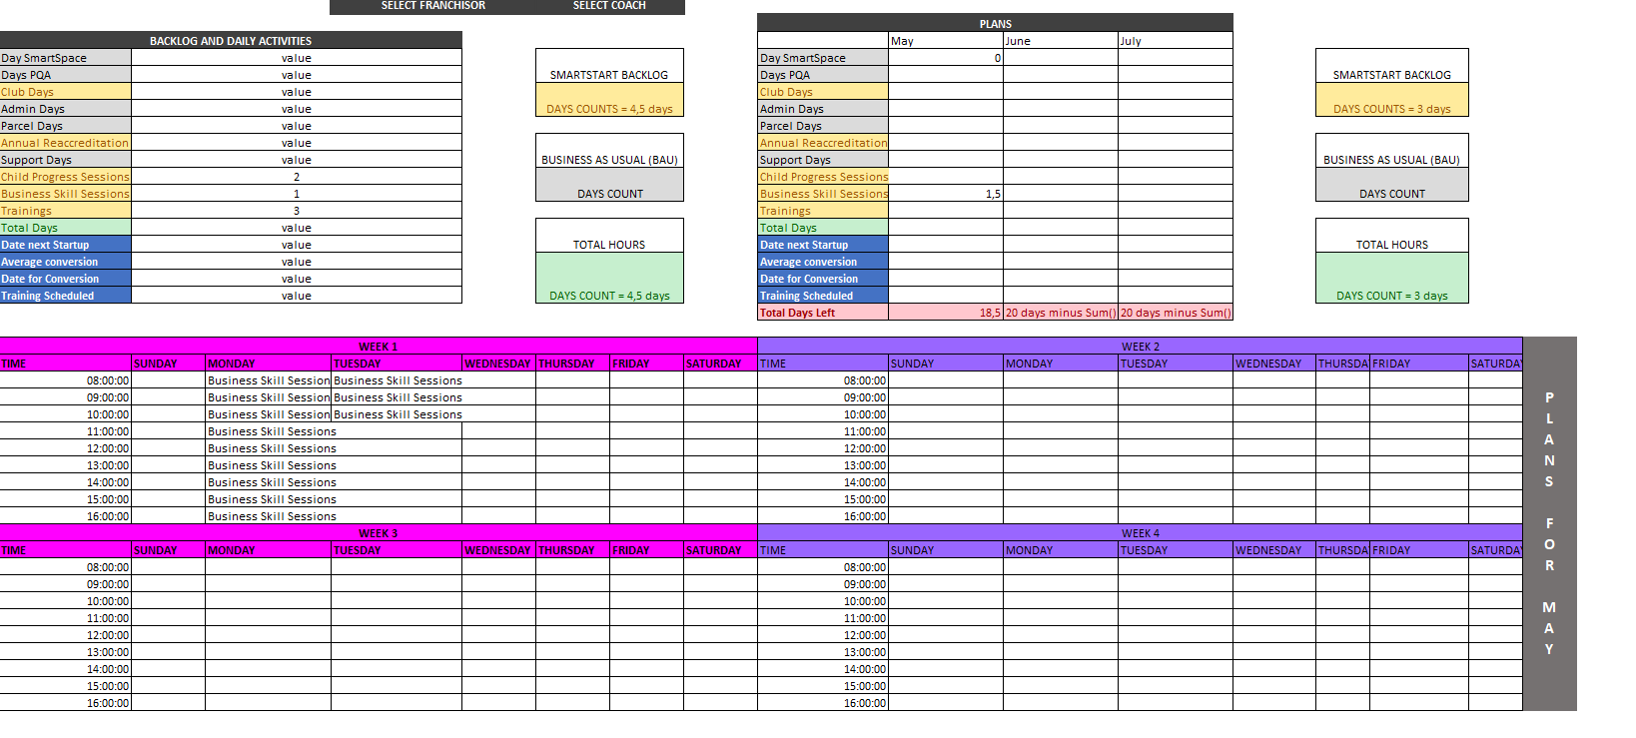
Coach planning tool
Summarised days the backlog will take to complete.
Days left after the planning has happened.
Select a coach or franchisor
Check the coaches backlog based on summary from the model.
Planning works hand in hand, the selected plan from the calender corresponds with the plans and calculates the days left.

Slide 3
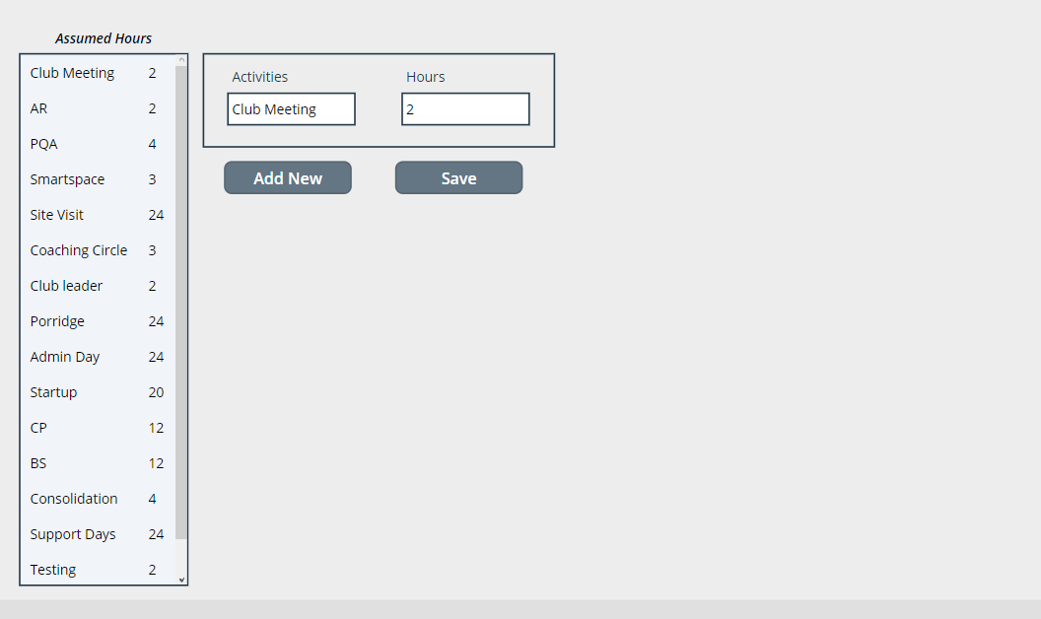

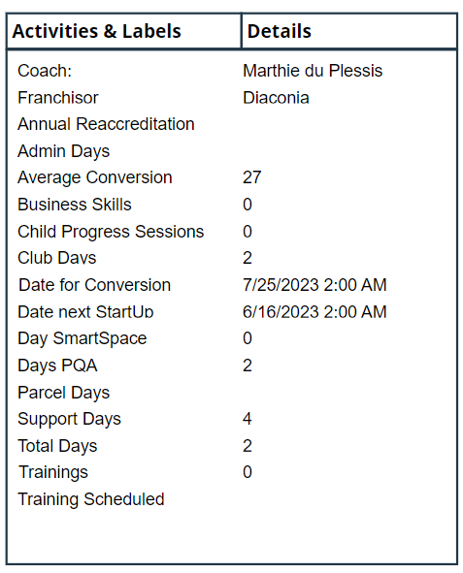
Coach planning tool – Power APPS

